Slide 1
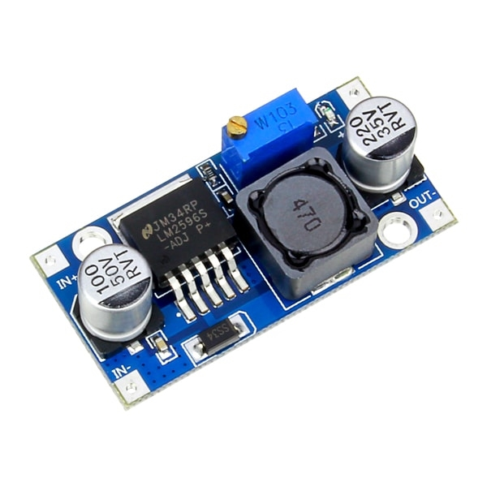
Buck Converter
By Andre Nguyen

Slide 2

What is a Buck Converter?
DC-to-DC converter that creates an output voltage lower than the input voltage.

Slide 3
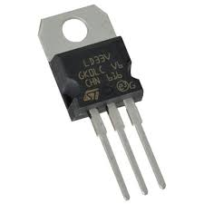
Not the Same
≠
Voltage Regulator
Buck Converter
Voltage ↓
Current ↓
Voltage ↓
Current ↑

Slide 4
Not the Same
≠
Voltage Regulator
Buck Converter
Voltage ↓
Current ↓
Voltage ↓
Current ↑

Slide 5
Not the Same
≠
Voltage Regulator
Buck Converter
Linear
Switching
Notes:
Linear uses resistive load to step down voltage
Switcing stores energy and releases it periodically

Slide 6
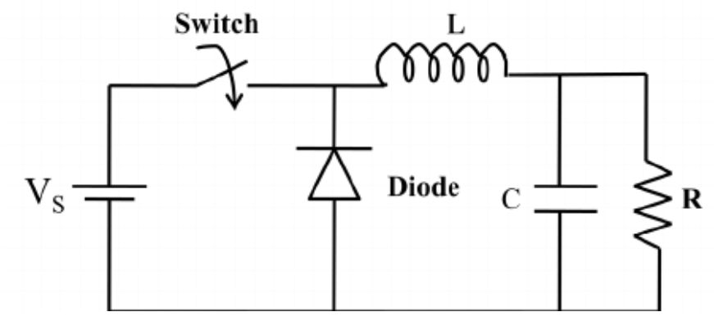
Main Components
Notes:
Switch typically MOSFET or IGBT controlled by a PULSE WIDTH MODULE (PWM)
Inductor stores the current
Capacitor store the voltage

Slide 7
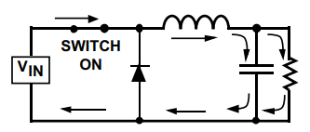
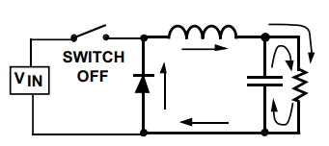
How does the voltage decrease?
Voltage drop across the inductor
Closed Switch:
Input is the main source of power
Inductor charges
Opened Switch:
Inductor is the main source of power
Inductor discharges

Slide 8
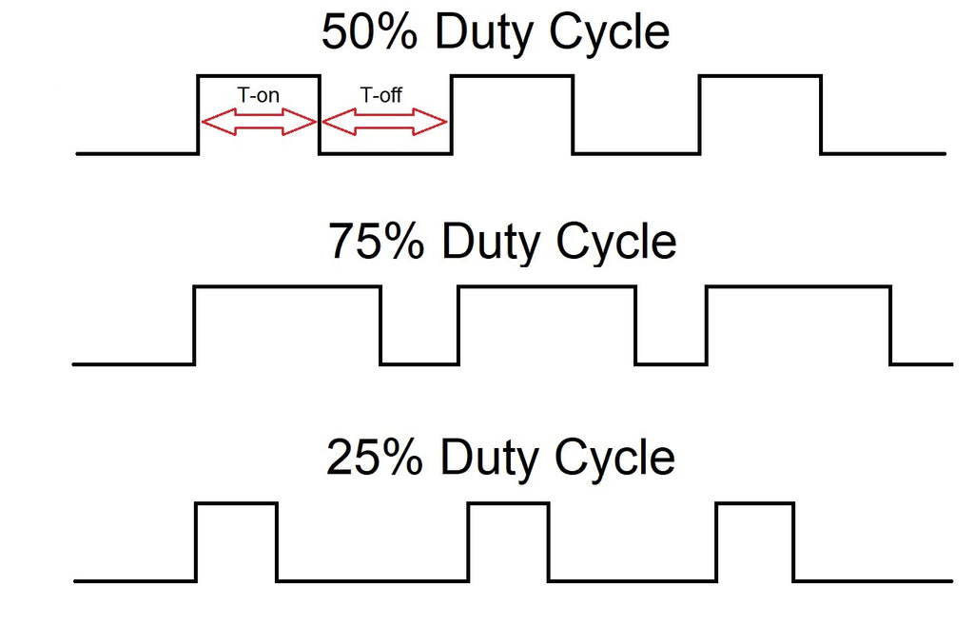

What is the Output Voltage?
Output Voltage Equation:
$$V_{R}= V_{S} ×D$$
$V_{S}$ = Input Voltage
$D$ = Duty Cycle

Slide 9

What is the Output Voltage?
Output Voltage Example:
$$V_{R}= V_{S} ×D$$
$V_{S}$ = 12 V
$D$ = 0.50
$$V_{R}=12×0.50=6 V$$

Slide 10

How does the current increase?
Closed Switch:
Current from voltage source
Opened Switch:
Current from the inductor
$$I_{S} < I_{S}+ I_{L}$$
Over time, the average sum of the source and inductor current is greater than the source current alone

Slide 11
How is the output energy steady?
Flywheel Circuit:
Allows the current to continuously flow even when the switch is open

Slide 12
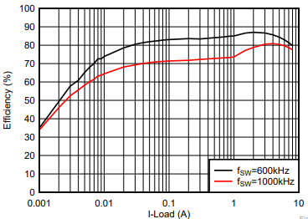
The Switch
Lower Frequency:
Efficiency ↑
Performance ↓
Higher Frequency:
Efficiency ↓
Performance ↑

Slide 13
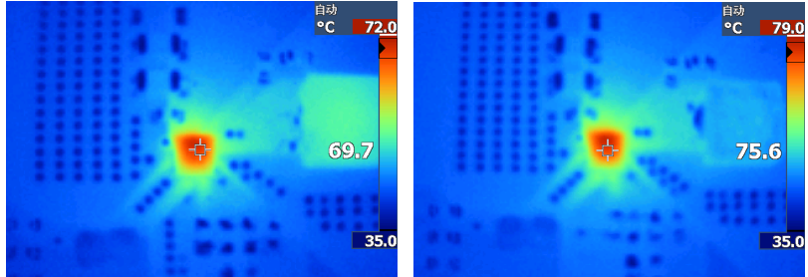
The Switch
Thermal at $f_{SW}=$600 kHZ
Thermal at $f_{SW}=$1000 kHZ
Thermal at $f_{SW}=$600 kHZ
Thermal at $f_{SW}=$1000 kHZ

Slide 14
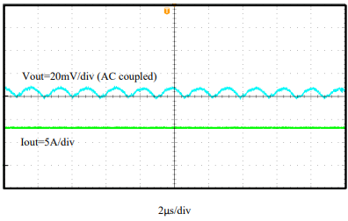
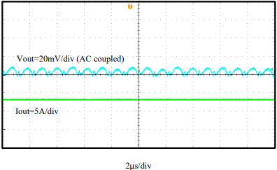
The Switch
Output Ripple Voltage at $f_{SW}=$600 kHZ
Output Ripple Voltage at $f_{SW}=$1000 kHZ
Thermal at $f_{SW}=$600 kHZ
Thermal at $f_{SW}=$1000 kHZ
Notes:
Higher heat equal less efficient

Slide 15
The Switch
Output Ripple Voltage at $f_{SW}=$600 kHZ
Output Ripple Voltage at $f_{SW}=$1000 kHZ
Thermal at $f_{SW}=$600 kHZ
Thermal at $f_{SW}=$1000 kHZ

Slide 16
References
“Learnabout Electronics.” Buck Converters, https://learnabout-electronics.org/PSU/psu31.php.
The Organic Chemistry Teacher, director. Buck Converter. YouTube, YouTube, 20 June 2020, https://www.youtube.com/watch?v=rfChSvb8FX0. Accessed 5 Mar. 2023.
“Power Supply Technology - Buck DC/DC Converters.” Mouser Electronics, https://www.mouser.com/applications/power-supply-topology-buck/.
“Switching Regulator Fundamentals.” Texas Instruments, https://www.ti.com/lit/pdf/slvaed3.

